Slide 1
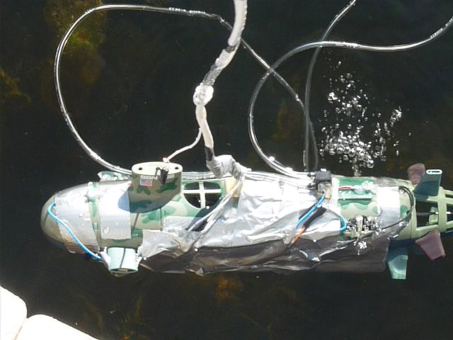
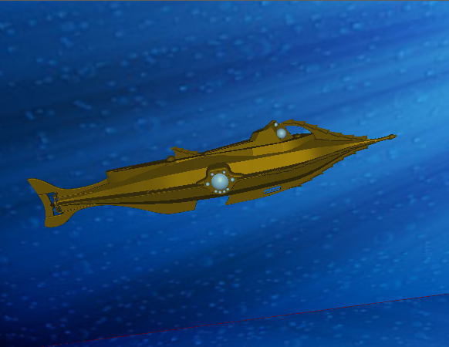
Realtime 3-D Modeling of a Remotely Operated Vehicle
The ROVing Lunatics
Paul Booth, Jon McKay, Tom Pandolfo
Goal
To obtain a realtime, 3-D display of the position and orientation of an ROV
Accelerometer
Differential Pressure Sensor
IR LEDs
Our ROV with sensors attached. The accelerometer is used to calculate orientation (pitch and roll) while the pitot tube determines velocity. The IR LEDs are detected by a Bluetooth infrared camera to determine the yaw of the submarine. All sensors were attached directly to the ROV using duct tape and hot glue, also helping to waterproof.
The virtual submarine is rendered in Labview using Picture3D. The 3-D model is a SolidWorks assembly that we converted to a WRML 3-D object. By combining the measured angles and velocity, we can use a single integration to obtain the position of the submarine at any point in time from some starting position. By combining the translational transformation of the current position with the rotational transformation corresponding to the measured angles, we can display the predicted position and orientation in realtime, updating to simultaneously show the velocity.

Slide 2
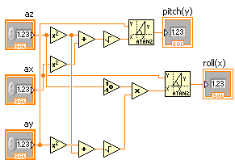
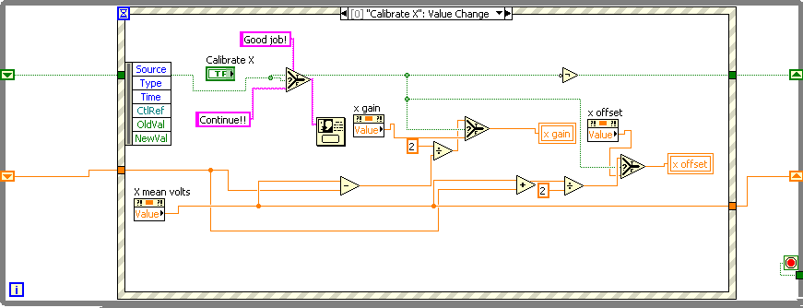
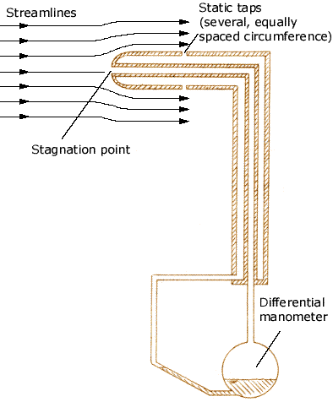
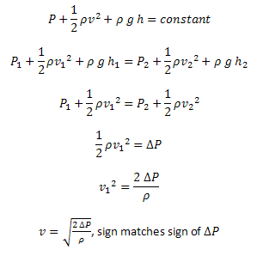
Accelerometer
Error Sources
- Get voltage from accelerometer using DAQ Assistant
- Subtract offset (when level, outputs about half of maximum voltage)
- Multiply by gain to convert to acceleration (g’s)
- Calculate pitch and roll (inverse tangent of acceleration in one direction and the signed magnitude of the acceleration in the other two directions)
- Rotate around correct axes
to apply the pitch and roll
- Pitot tube works in one direction – waves
- Batteries do not always supply exactly 1.5V
- Air in pitot tube is compressible
- Problems at the surface when tilted up
- Indistinguishable accelerometer tilt positions
- Interference with IR LEDs, reflection, other sources
- Non-level calibration
- DAQ, electronics tolerances
- Integration error/ bad offsets
Calibration:
-Known +/- 1 g extreme values of acceleration and linear V-g mapping
Pitot Tube
-match max/ min voltages with +1/-1 g for instant calibration
Future Work
Bernoulli’s equation
Improved tracking of IR LEDs or other methods of yaw detection (compass, gyroscope, etc.)
Better handling of ambiguous pitch-roll angles
Better waterproofing
More exact neutral buoyancy (slowly sinks)
Automatic calibration
Autonomy
-Get voltage in
Apply offset
Multiply by gain of 1 Pa/V
Multiply by two, divide by 1000 kg/m^3, square root
Multiply by the change in time since last update for consistent updates and actual units
Increment current position based on magnitude of velocity and angles.
Calibrate by replacing offset with current value while at rest- pressure difference and velocity go to zero
IR LEDs
Conclusion
We have managed to produce a 3-D realtime display of the position, velocity, and orientation of a toy submarine. The data collected from all sources is combined and analyzed to create and render a virtual representation of our physical ROV.
PixArt IR sensor housed in Wiimote
IR camera gets IR picture
Track blobs of IR light from LEDs
Send positions over bluetooth to LabView
Inverse tangent of difference in y positions and difference in x positions to get yaw relative to the Wiimote
as long as the Wiimote is not turned, it can be translated to continue tracking the ROV
Sources
http://www.efunda.com/designstandards/sensors/pitot_tubes/images/Pitot_tube_B.gif

